Slide 1

Slide 1
Customer Personality Analysis
Insights on customers behaviors for the company

Slide 2
Analysis Main Topics
There will be 5 main topics covered in the analysis :
Income and spendings of customers for different categories of customers (e.g. Income categories, Education, Marital Status, Number of children).
Offer Camps and Discounted Purchases for different Income Categories.
Types of products mostly purchased by customers (e.g. Meat, Fish, etc.).
Purchase methods used by customers (e.g. Store, Web, Catalog).
Classifying Customers into 4 categories based on their Income & Spendings.

Slide 3
Income and Spendings

Slide 4
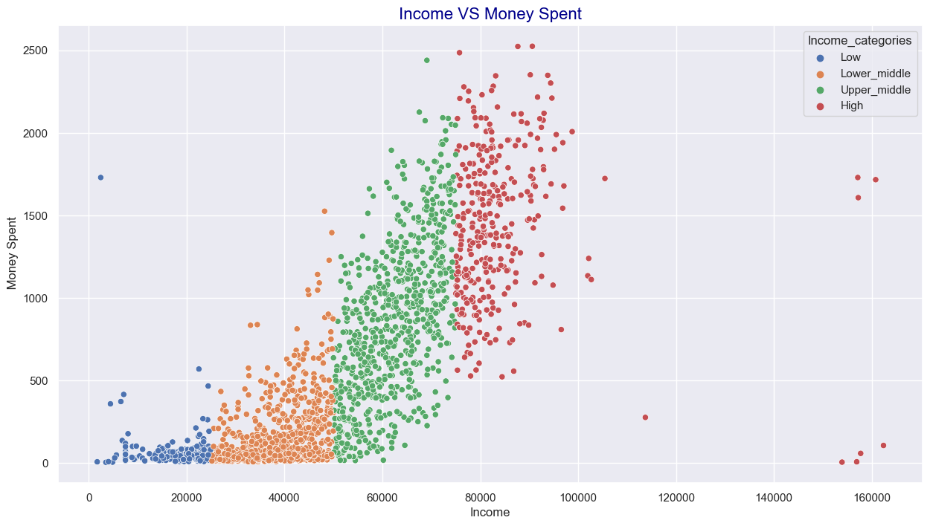
Income & Spendings for different Income Categories
Customers are categorized into the following 4 categories by their Income :
- Low : Income > 25000 - Lower middle : 25000< Income < 50000
- Upper middle : 50000 < Income < 75000 - High : Income > 75000

Slide 5
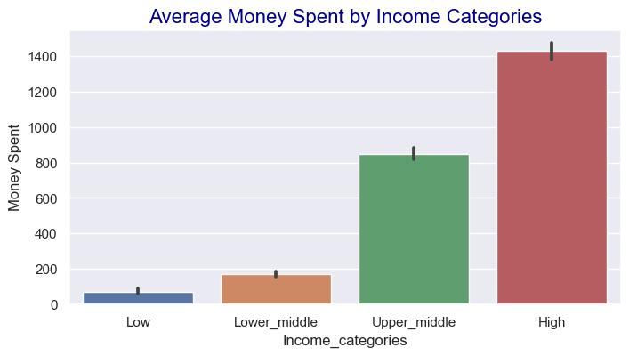
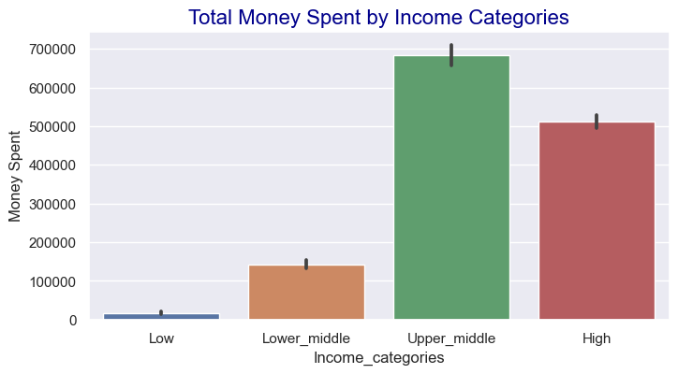
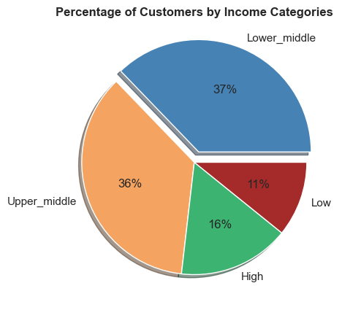
Slide 2
2

Slide 6
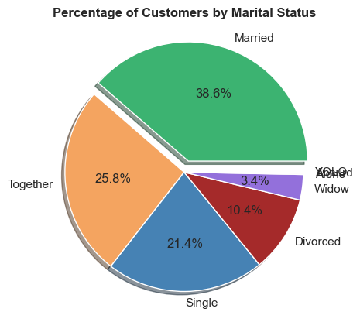
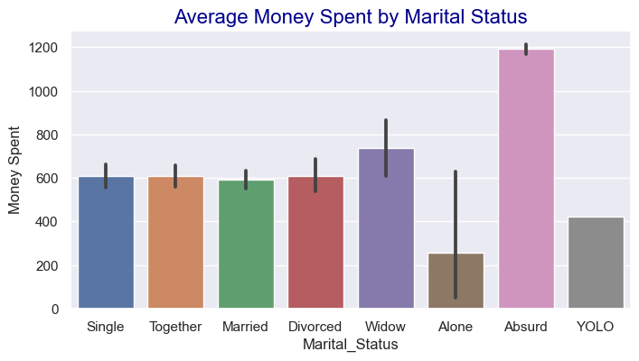
Slide 3
Income & Spendings by Marital Status
3

Slide 7
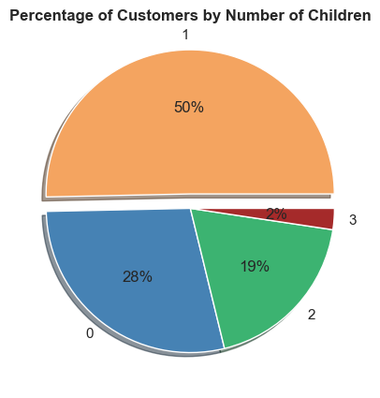
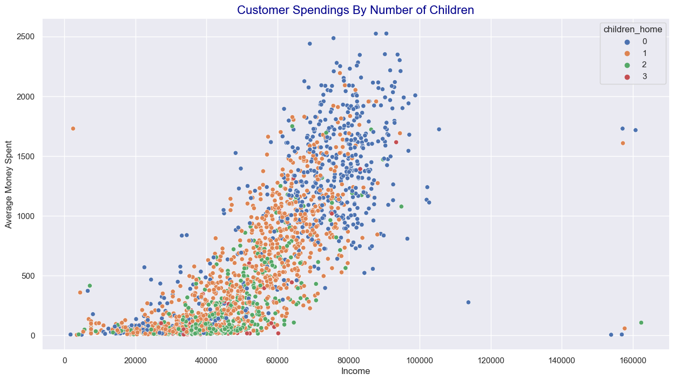
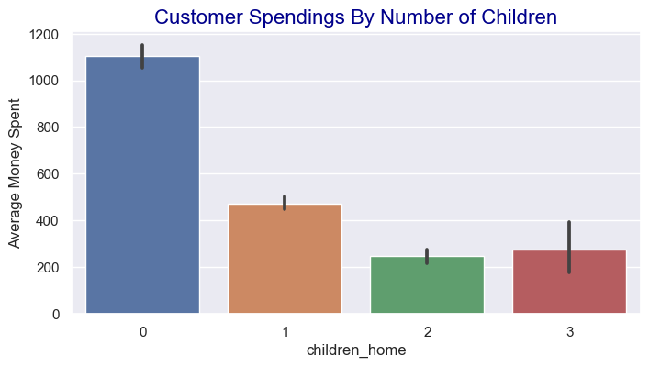
Slide 4
Income & Spendings for different number of children
4

Slide 8
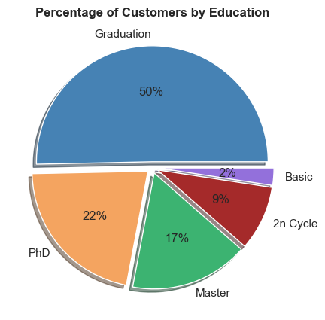
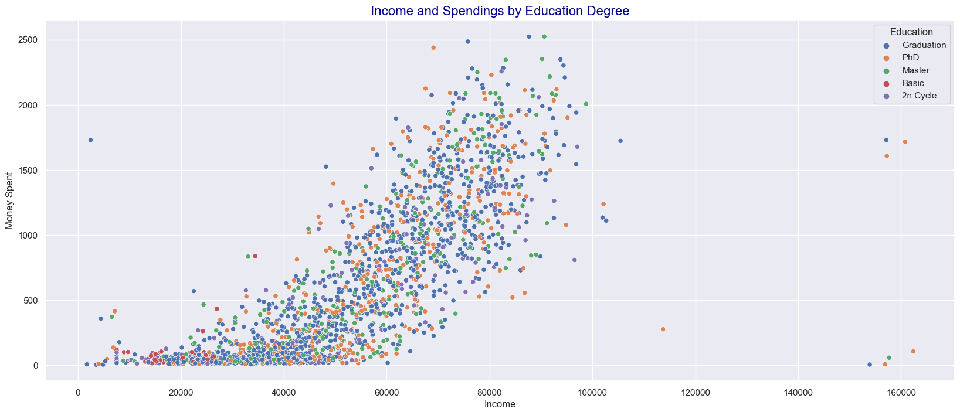
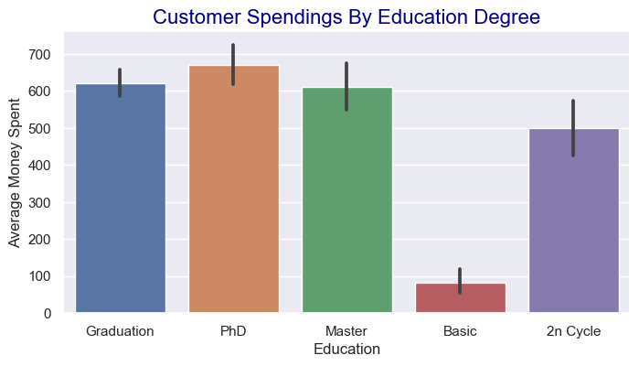
Slide 5
Income & Spendings by Education Degree
5

Slide 9
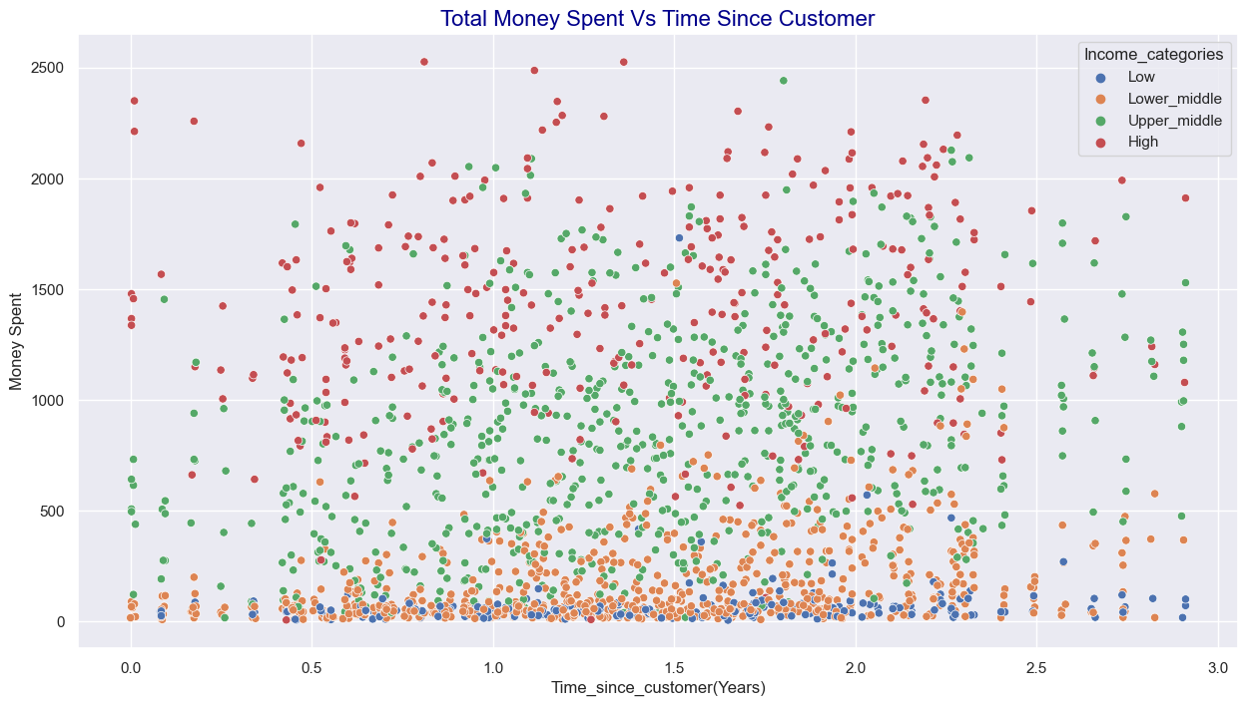
Slide 6
Money spent of new and old customers
6

Slide 10
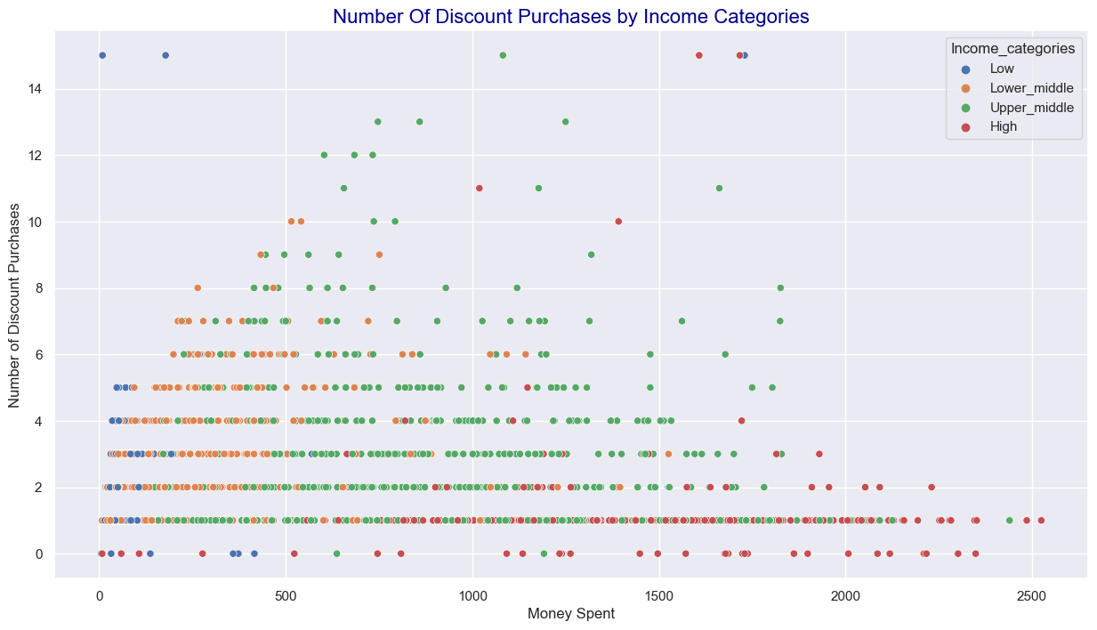
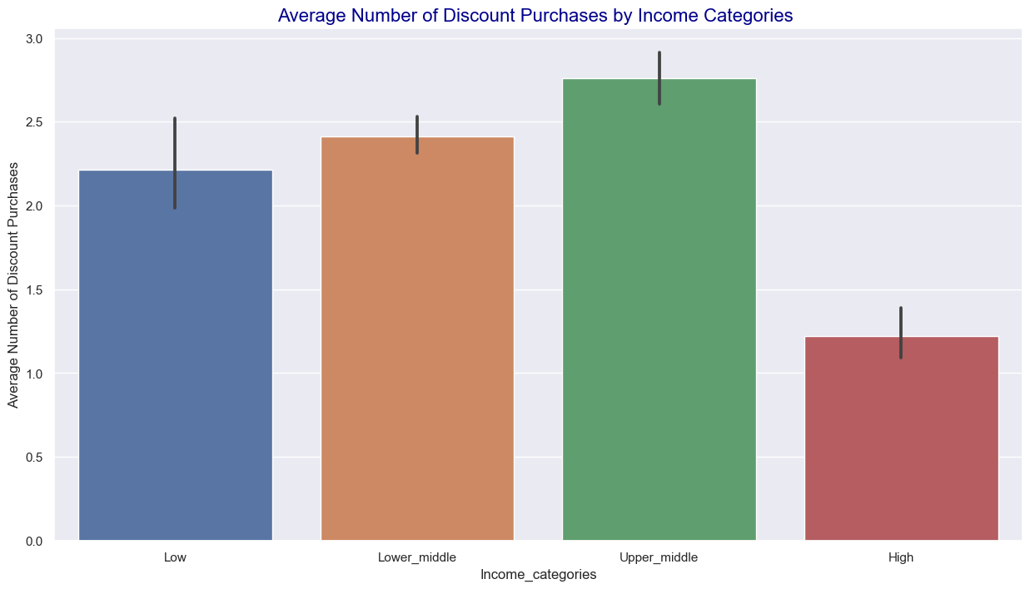
Slide 7
Discount Purchases and Money Spent for Income Categories

Slide 11
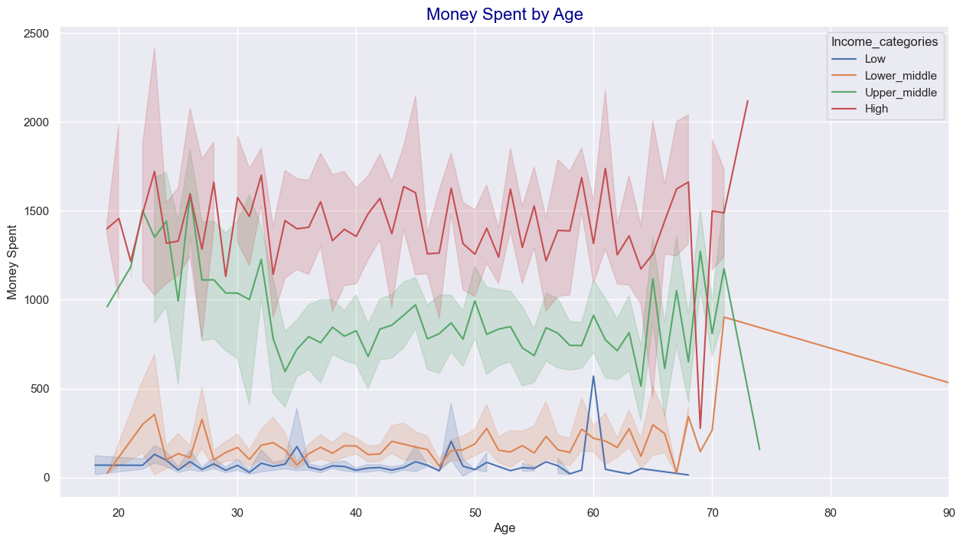
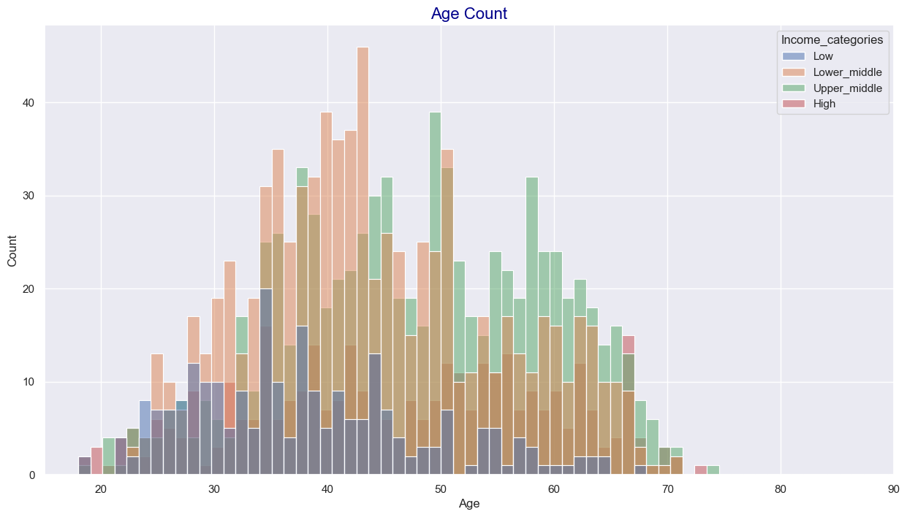
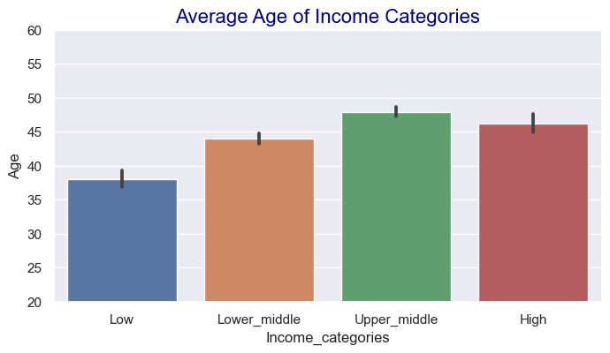
Slide 8
Income & Spendings with age
8

Slide 12
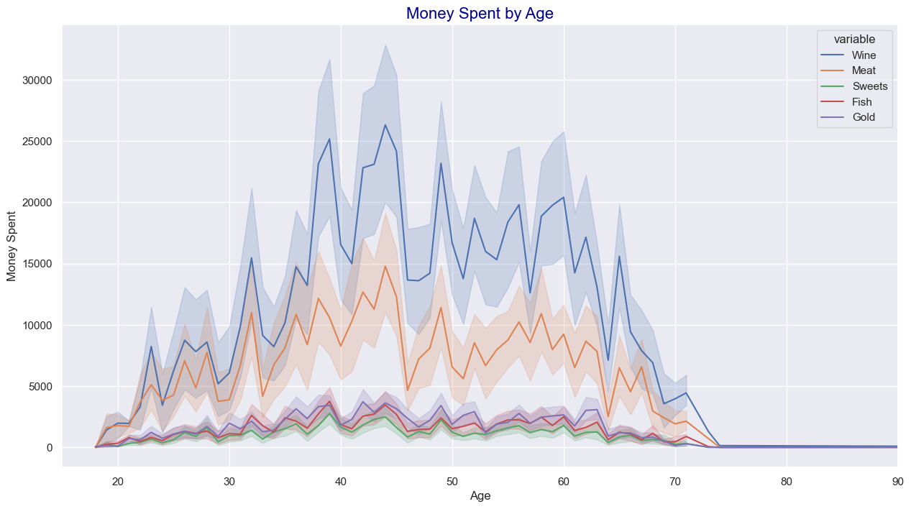
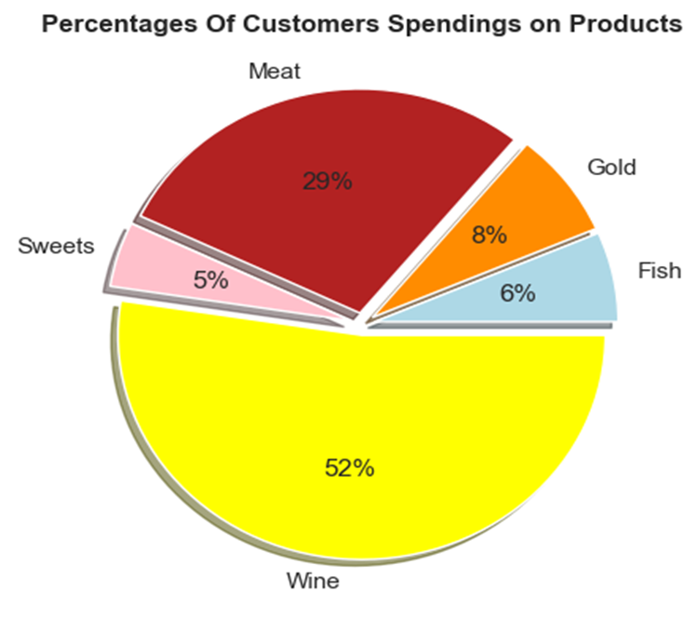
Types of products purchased by customers

Slide 13
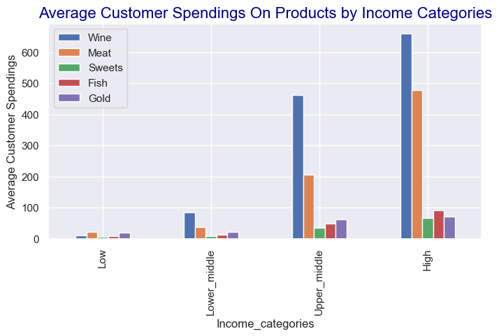
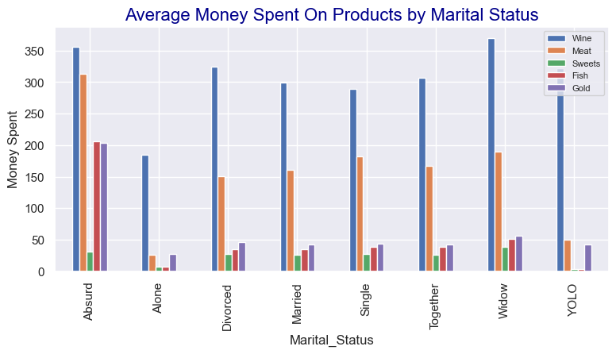
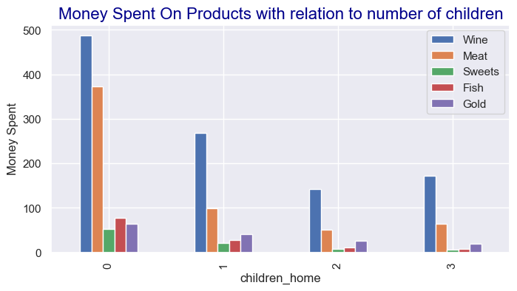
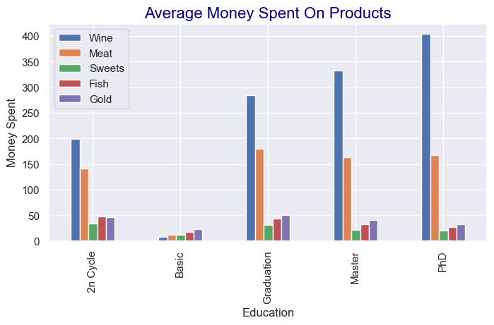
Slide 9
Products purchased by various customers Categories
9

Slide 14
Slide 10
Methods of Purchase
10

Slide 15
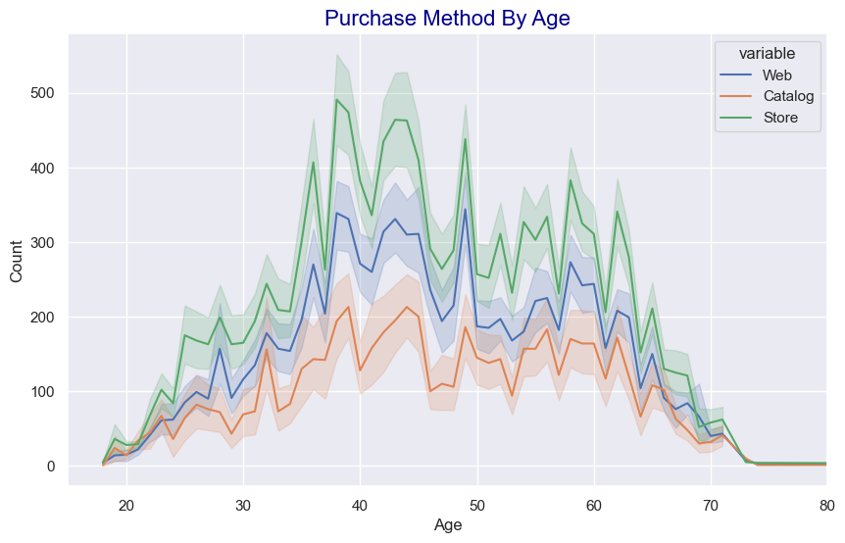
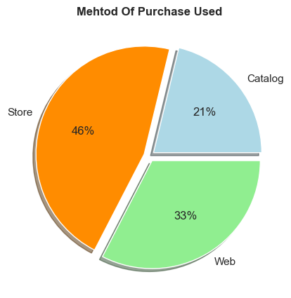
Products purchased by various different methods

Slide 16
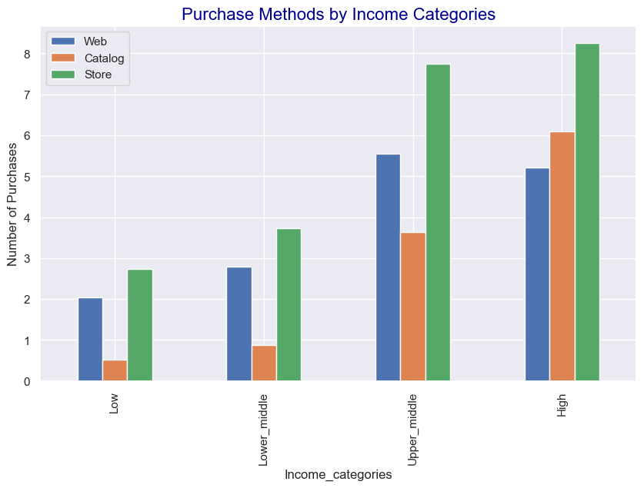
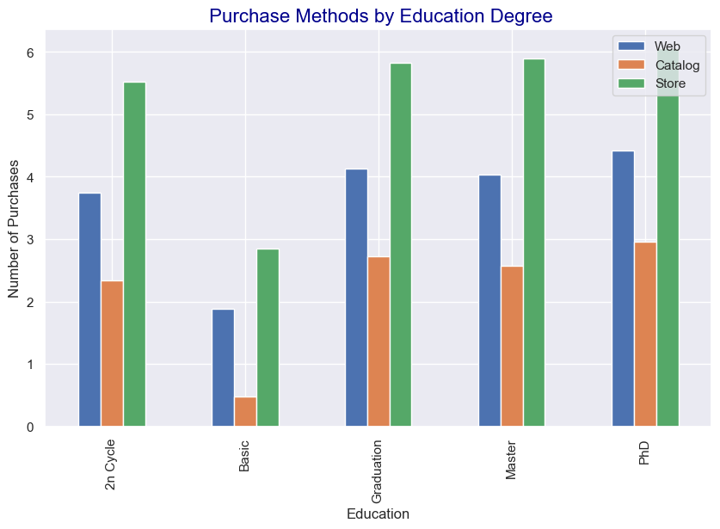

Slide 17
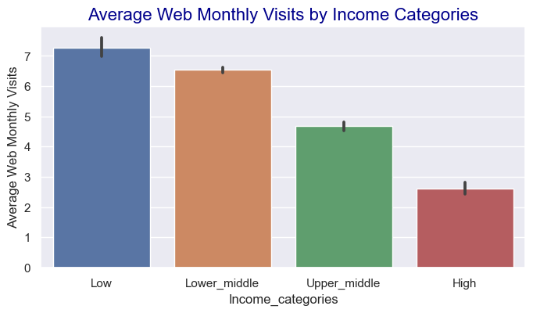
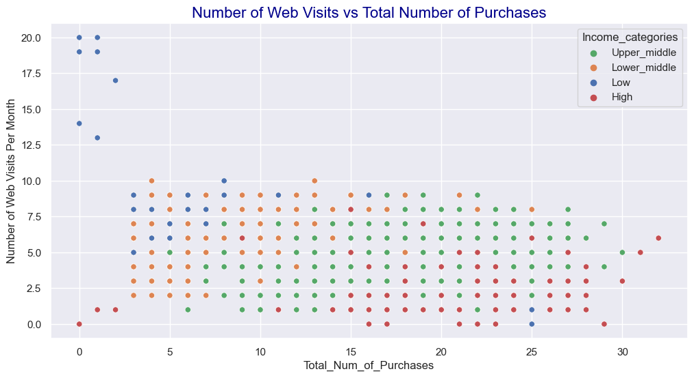
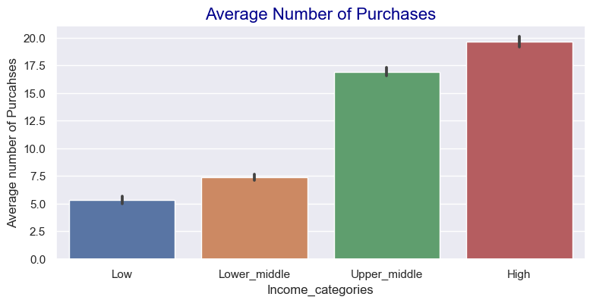
Web Monthly Visits various customers Categories:
- Low income categories visit the web the most, but have the least number of Purchases.
- As the income increases, web visits decrease and the total number of purchases increase.

Slide 18
Offer Camps and Discounted Purchases

Slide 19
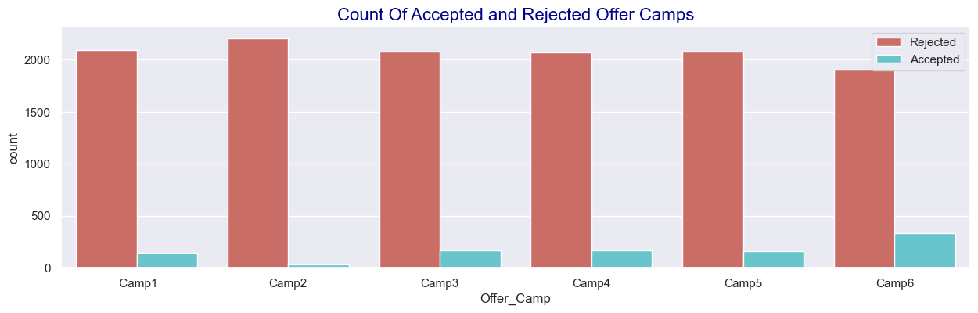
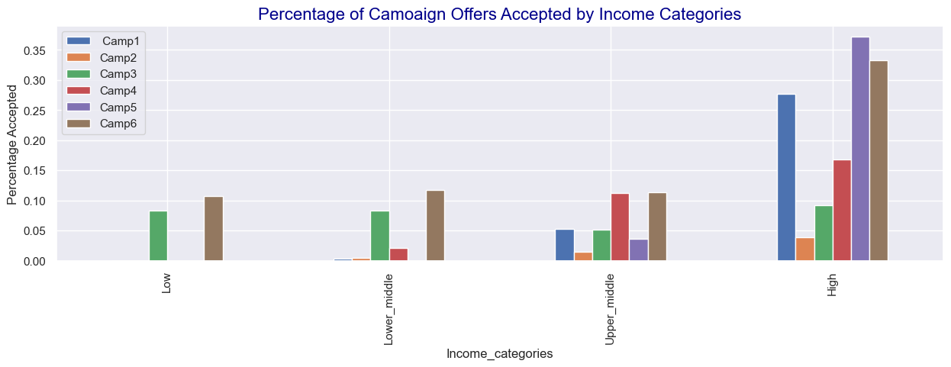
Offer Campaigns

Slide 20
Classifying Customers

Slide 21
Classifying Customers
Customers are classified into 4 categories:
High Income and Spendings : Customers with higher than average income and higher than the median spendings.
Low Income and Spendings : Customers with lower than average income and lower than the median spendings of customers.
Very Loyal : Customers with lower than average income and higher than the median spendings of customers.
High Potential :: Customers with higher than average income and lower than the median spendings of customers.
In customer spendings, the median is taken as benchmark because the distribution is skewed. The mean would give a biased value.

Slide 22
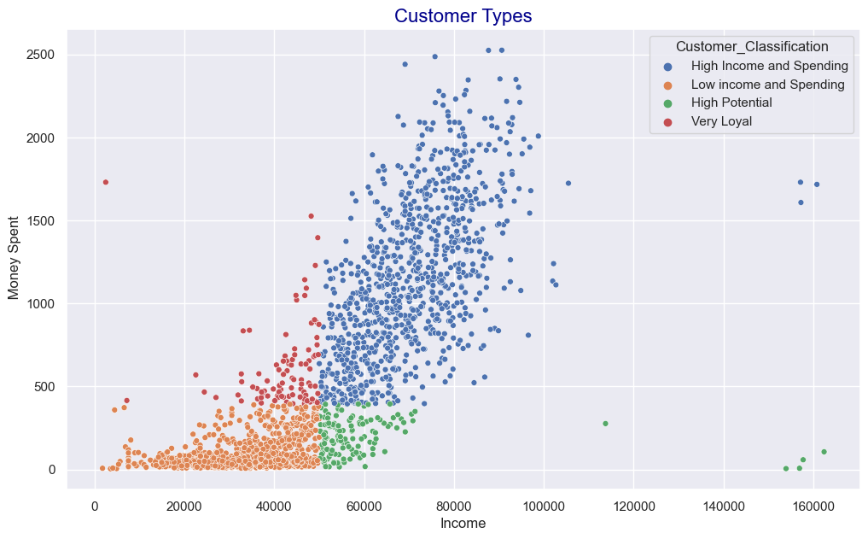
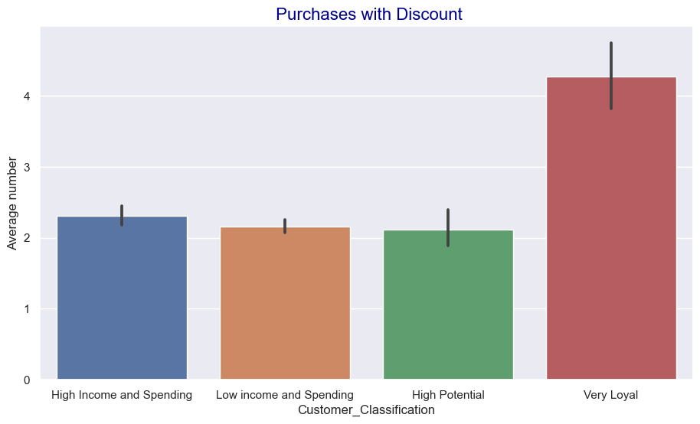
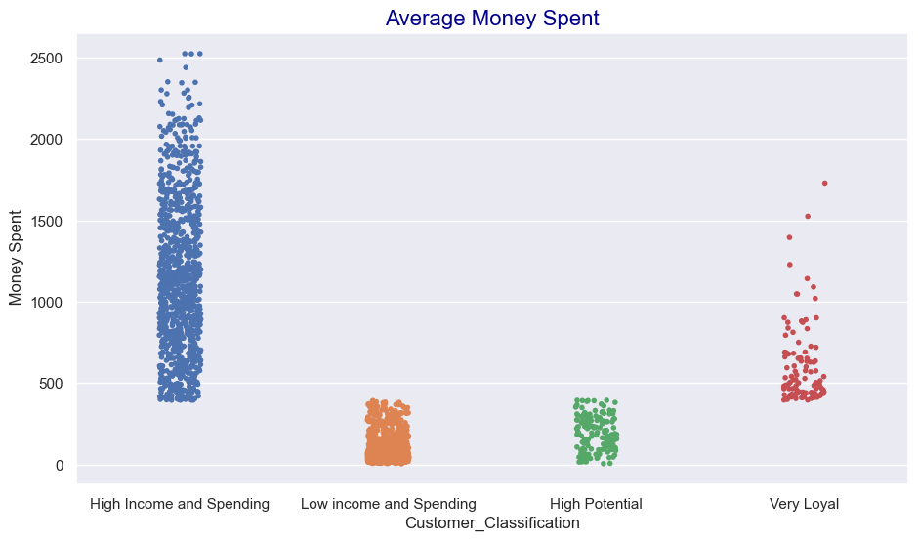
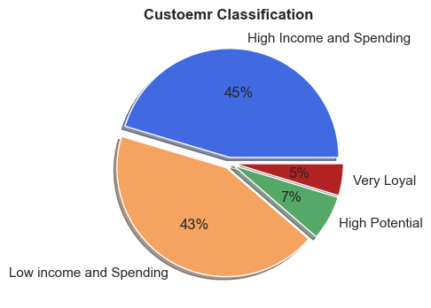
Classifying Customers

Slide 23
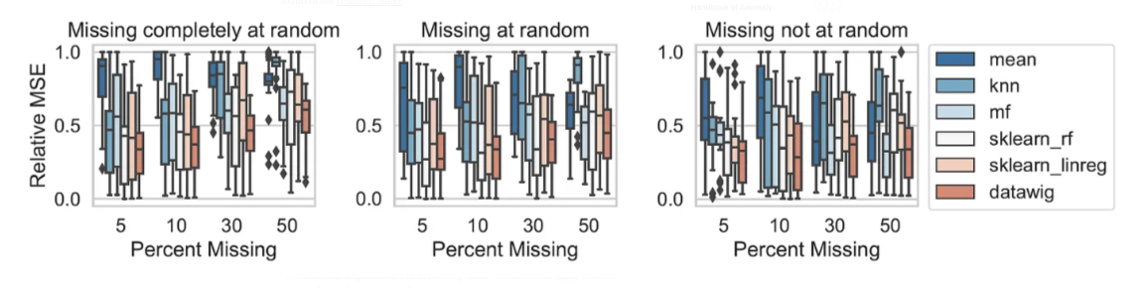
Machine Learning Models Used
Missing Values Imputation
- Datawig is a library that learns Machine Learning models using Deep Neural Networks to impute missing values in a dataframe.
Quite accurate compared to other methods.
It has some functions that can handle categorical data (Feature Encoder).
Income missing values was imputed in the Customer Personality dataset.
Age and member gender missing values were imputed in the bikeshare dataset.

Slide 24
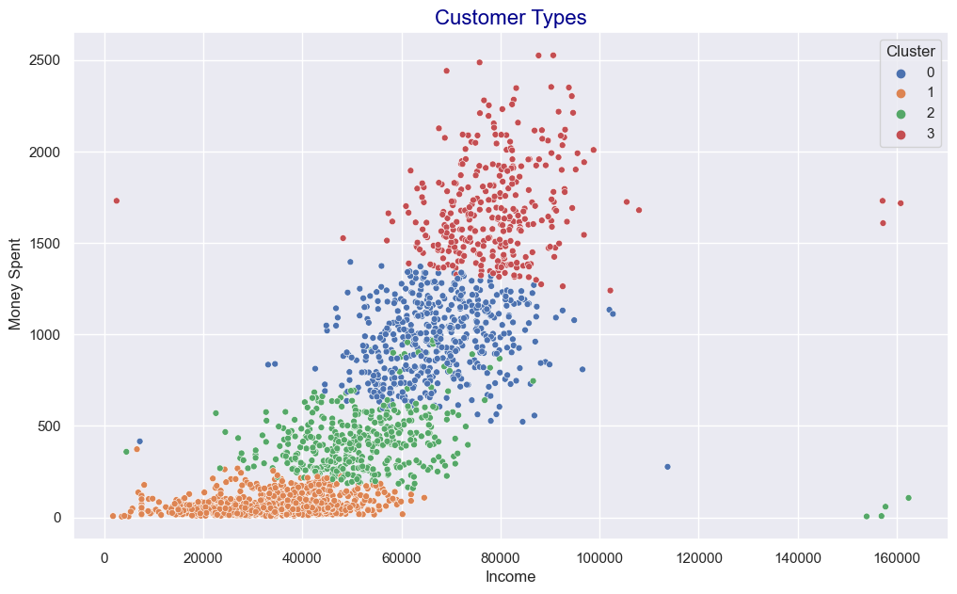
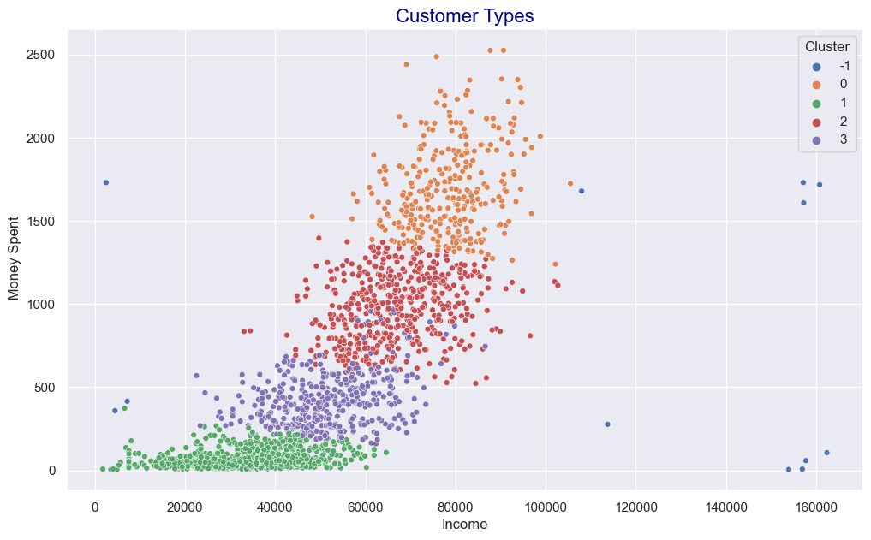
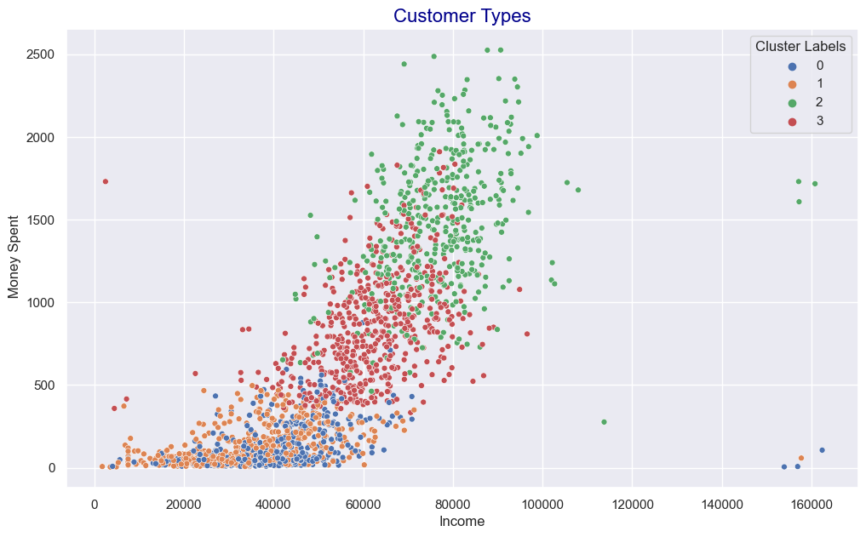
Clustering Algorithms Used
Customers were categorize into different clusters using different Models.
K_means -DBSCAN - K_prototype

Slide 25
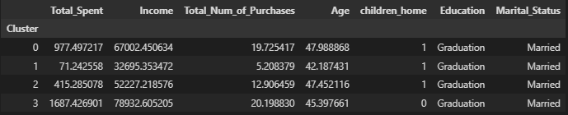
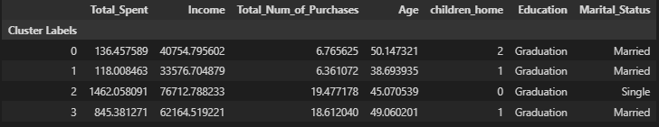
K_Means and K_Prototype Clusters Comparison
K_Means
K_Prototype

Slide 26

Slide 11
THANK YOU

